Slide 1
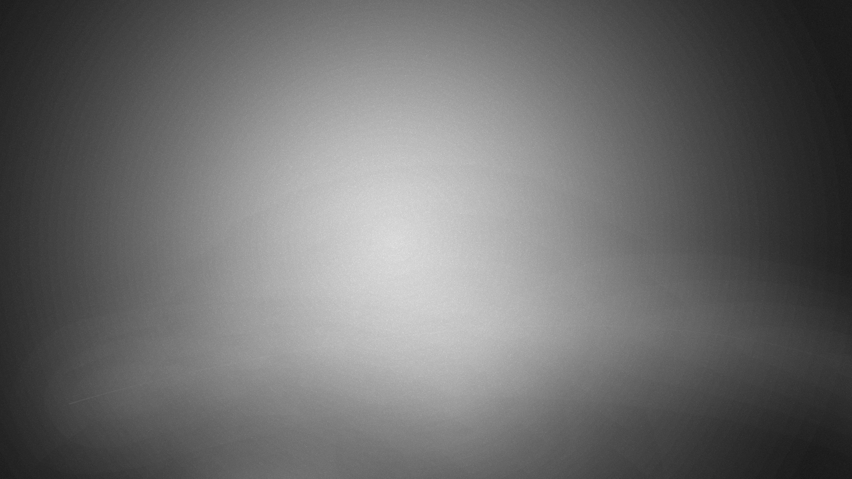


Faster hologram generation by using Max-Length-Depth-Range method
MD SIFATUL ISLAM
Masters student, OIP lab, Chungbuk National University
Email : sifatul@CBNU.ac.kr

Slide 2



Table of contents
Introduction
Motivation
Conventional Multiple-Wavefront Recoding Plane (M-WRP) method
Proposed Max-Length-Depth-Range (MLDR) method
Results and Summary

Slide 3
Introduction
Brown and Lohmann proposed the computer-generated hologram (CGH) in 1967 [1] but real time full colour hologram generation remains a challenge. There are various techniques for full colour CGH generation: the point cloud approach, polygon-based approach, and the depth plane approach.
The point cloud approach is more popular because it samples spherical waves from point sources, which are superposed onto the plane of the hologram. It is simple, flexible, and accurate, but iteration of each individual point makes it computationally costly.
In addition to using a GPU, some researchers reduced the calculation time by applying look-up tables. However, this requires a large amount of memory. The wavefront recording plane (WRP) [2] is an excellent method to reduce computational time using point cloud approach.
A. W. Lohmann and D. P. Paris, “Binary Fraunhofer holograms, generated by computer,” Appl. Opt. 6, 1739–1748 (1967).
T. Shimobaba, N. Masuda, and T. Ito, “Simple and fast calculation algorithm for computer-generated hologram with wavefront recording plane,” Opt. Lett. 34, 3133–3135 (2009).
Notes:
1. Tomoyoshi Shimobaba, Nobuyuki Masuda, and Tomoyoshi Ito, "Simple and fast calculation algorithm for computer-generated hologram with wavefront recording plane," Opt. Lett. 34, 3133-3135 (2009)

Slide 4
Wavefront recording plane (WRP) method
The WRP is a small virtual window placed between the object plane and the hologram plane. The computation time required to generate a CGH can be reduced by calculating the complex amplitude of a small region (active area [Eq.1]) of the WRP, rather than over the entire holographic plane.
Still, distance between WRP and farthest object point is far; which increases the active area size and thus needs much reduction of calculation time. Fortunately, usage of multiple WRP method reduces the calculation time farther.
R_{j}
WRP
Active area
Eq. 1
CGH
Fig 1. Schematic diagram of hologram generation
Notes:
1. Tomoyoshi Shimobaba, Nobuyuki Masuda, and Tomoyoshi Ito, "Simple and fast calculation algorithm for computer-generated hologram with wavefront recording plane," Opt. Lett. 34, 3133-3135 (2009)

Slide 5
Multiple Wavefront recording plane (M-WRP) method
In M-WRP method firstly depth range is created with fixed number of depth layers and WRP is placed in the center of each depth range [Fig 2.].
The light wave from 3D objects is recorded respective WRP [Eq. 2].
Light wave from WRPs to CGH is diffracted based on fast Fourier transform (FFT) [Eq. 3]
Depth range 1
WRP 1
Depth range 2
WRP 2
Depth range 3
WRP 3
Depth range k
θ
WRP k
Eq. 2
Diffraction
CGH
Eq. 3
Fig 2. Schematic diagram of conventional multiple wavefront recording method
Notes:
1. Tomoyoshi Shimobaba, Nobuyuki Masuda, and Tomoyoshi Ito, "Simple and fast calculation algorithm for computer-generated hologram with wavefront recording plane," Opt. Lett. 34, 3133-3135 (2009)

Slide 6

Motivation
Point cloud of real objects => depth ranges => discreet distance between WRP and object points
Fixed interval between WRP and fixed number of layers within a depth range make distance between WRP and farthest depth layer (within a depth range) to be big. Thus increases active area size and resulting in long computational time.

Slide 7
Max-Length-Depth-Range (MLDR) method
Depth range 1
MLDR method calculates CGH in following steps:
L is calculated for different values of active area dimension [Eq. 4]
Depth range is created based on step 1
WRP is placed in the center of each depth range
The light wave from 3D objects is recorded respective WRP [Eq. 2] and then CGH is created [Eq. 3]
Step 1 is repeated for all colors red, green and blue to find L_{R}, L_{G}, L_{B} which generate CGH in minimum time
L
Depth range 2
L
Depth range 3
L
Depth range k-1
θ
L
Depth range k
L
Diffraction
Eq. 4
CGH
Fig 3. Schematic diagram of hologram generation using MLDR method
Notes:
1. Tomoyoshi Shimobaba, Nobuyuki Masuda, and Tomoyoshi Ito, "Simple and fast calculation algorithm for computer-generated hologram with wavefront recording plane," Opt. Lett. 34, 3133-3135 (2009)

Slide 8
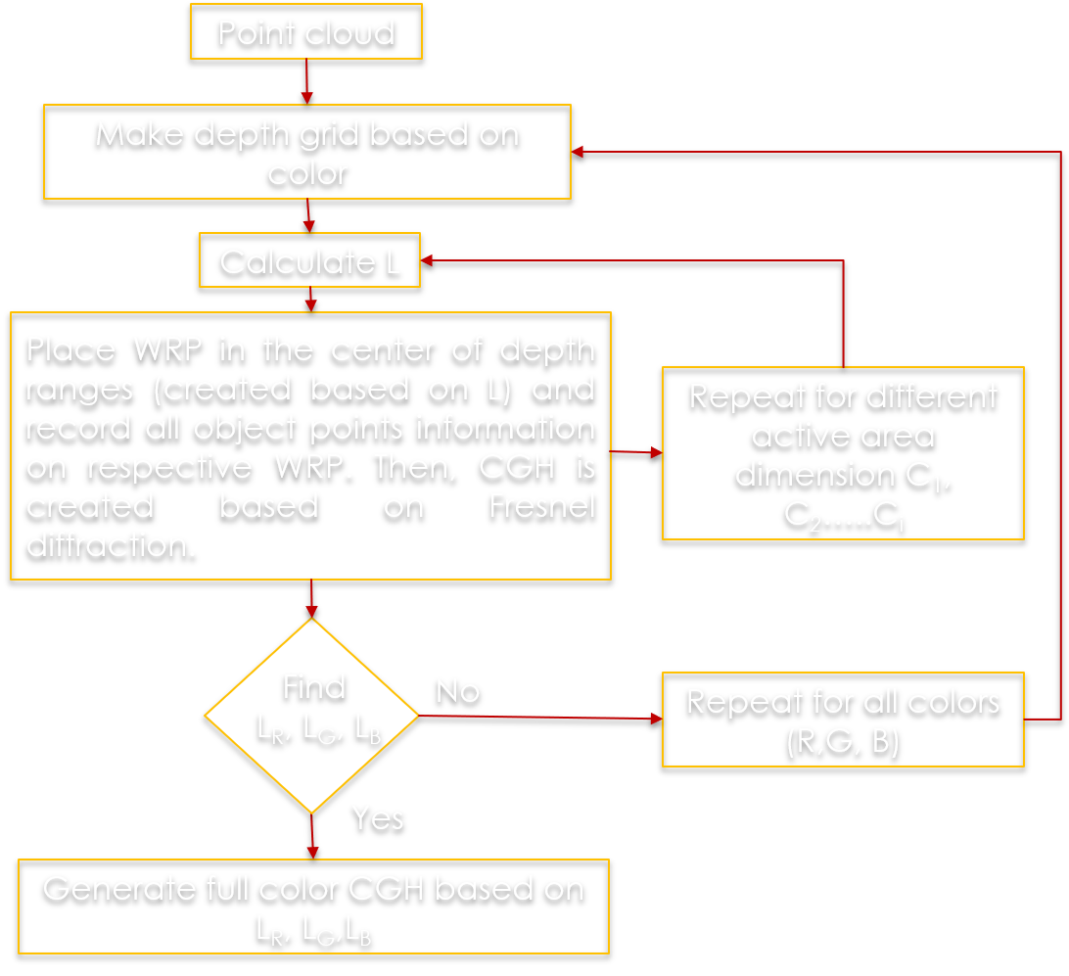
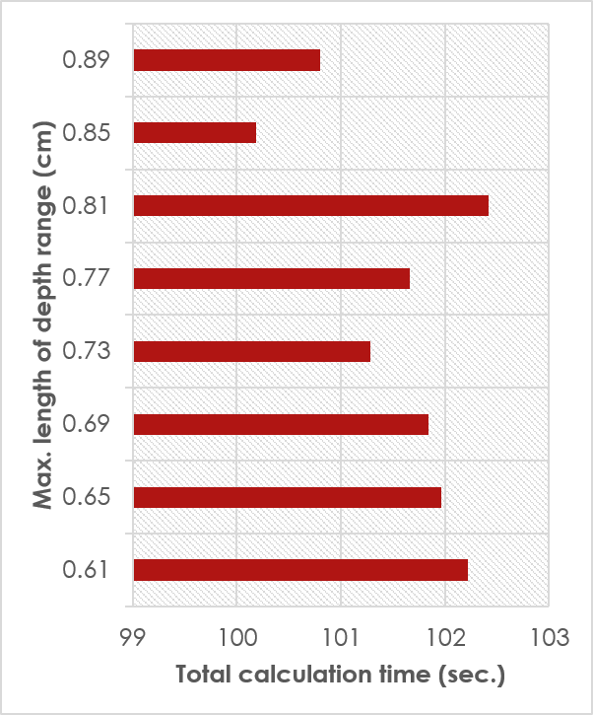
Max-Depth-Range-Length (MDRL) method
Fig 4. Flow chart of MLDR method
Fig 5. CGH generation time based on different values of L_{R}
Notes:
1. Tomoyoshi Shimobaba, Nobuyuki Masuda, and Tomoyoshi Ito, "Simple and fast calculation algorithm for computer-generated hologram with wavefront recording plane," Opt. Lett. 34, 3133-3135 (2009)

Slide 9
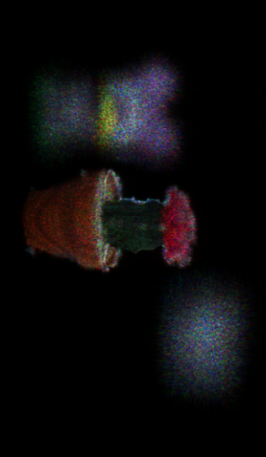
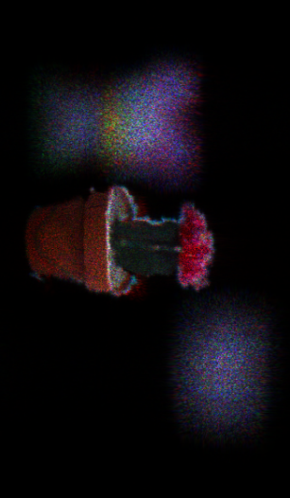
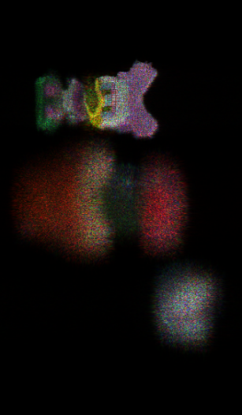
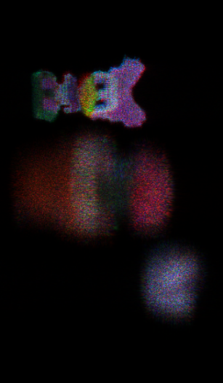
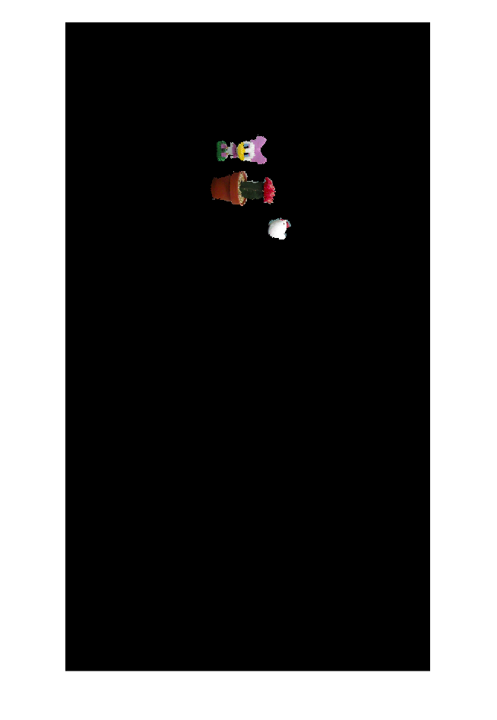
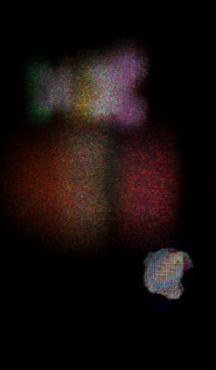
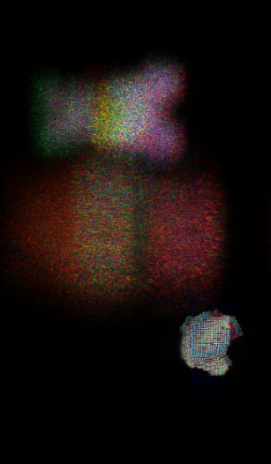
Result
Scene 1 |  | Calculation time(sec.)
Conventional M-Method | 2 WRPs ∕ color × 3 | 139.8135
 | 4 WRPs ∕ color × 3 | 136.7195
 | 8 WRPs ∕ color × 3 | 130.4805
 | 16 WRPs ∕ color x 3 | 131.4405
 | 32 WRPs ∕ color ×3 | 179.0325
 | 64 WRPs ∕ color × 3 | 195.0185
MLDR method | 4 WRPs (Red) 2 WRPS(Green) 3 WRPS (blue) | 93.441
Original Image
a) M-WRP
b) MLDR method
Fig. 5 : Reconstructed image for Scene 1- cactus, toy and hen - using a) conventional M-WRP b) MLDR method
Notes:
1. Tomoyoshi Shimobaba, Nobuyuki Masuda, and Tomoyoshi Ito, "Simple and fast calculation algorithm for computer-generated hologram with wavefront recording plane," Opt. Lett. 34, 3133-3135 (2009)

Slide 10
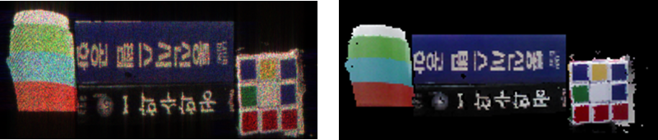
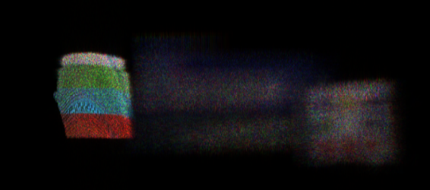
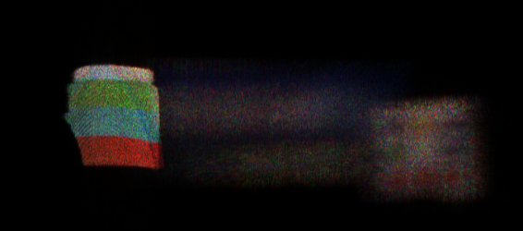
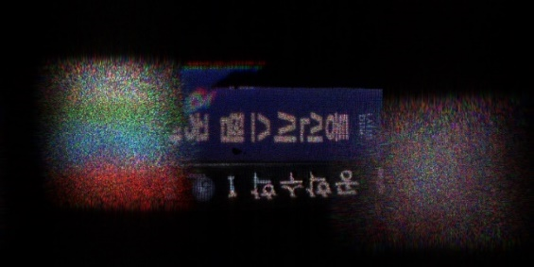
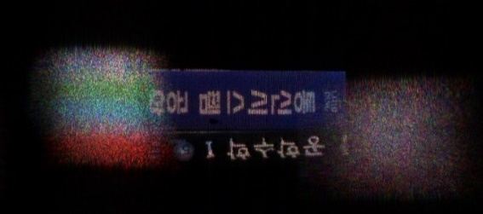
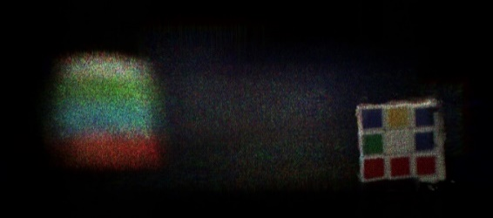
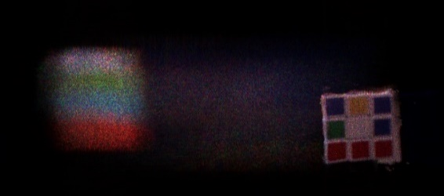
Result
Scene 3 |  | Cal. Time (sec.)
M-WRP method | 2 WRPs ∕ color × 3 | 390.893
 | 4 WRPs ∕ color × 3 | 156.906
 | 8 WRPs ∕ color × 3 | 181.009
 | 16 WRPs ∕ color × 3 | 198.155
 | 32 WRPs ∕ color × 3 | 214.048
 | 48 WRPs ∕ color × 3 | 223.189
Proposed method | 5 WRPs (red) 3 WRPS(green) 6 WRPS (blue) | 156.906
Original Image
a)
b)
Conventional MWRP
Proposed method
Fig. 5 : Reconstructed image for scene 2 - cube, book, cup - using a) conventional M-WRP b) MLDR method
Fig 2 : Depth ranges in conventional M-WRP

Slide 11
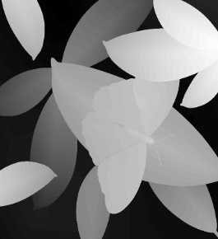
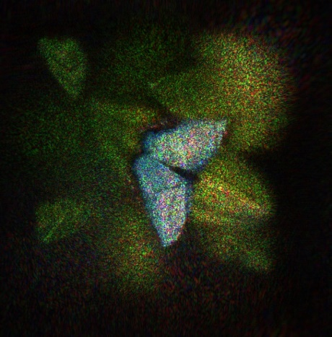
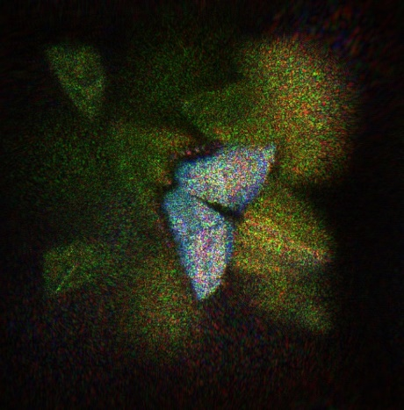

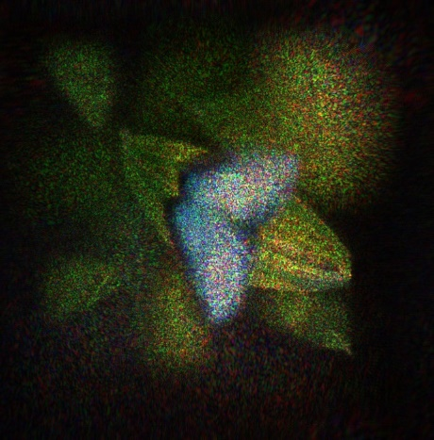
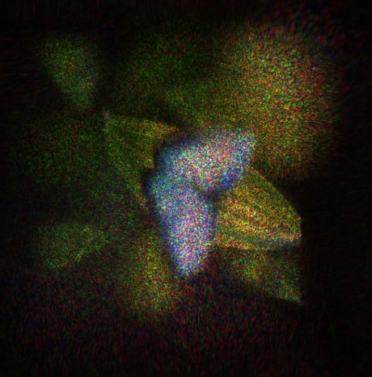
Result
Papillion (1980 X1024) |  | Cal. time(sec.)
M-WRP Method | 2 WRPs ∕ color × 3 | 448.867
 | 4 WRPs ∕ color × 3 | 319.926
 | 8 WRPs ∕ color × 3 | 264.556
 | 16 WRPs ∕ color × 3 | 268.737
 | 32 WRPs ∕ color × 3 | 258.756
 | 64 WRPs ∕ color × 3 | 270.052
 | 128 WRPs ∕ color × 3 | 295.414
MLDR method | 11 WRPs (red) 11 WRPS(green) 8 WRPS (blue) | 220.488
b)
a)
b)
c)
a)
b)
c)
Fig. 5 : a) Depth (top) and color image (bottom) of Papillion. c) Reference image and reconstructed image for ‘Papilion’ using e) conventional M-WRP f) MLDR method
Conventional MWRP
Proposed method

Slide 12
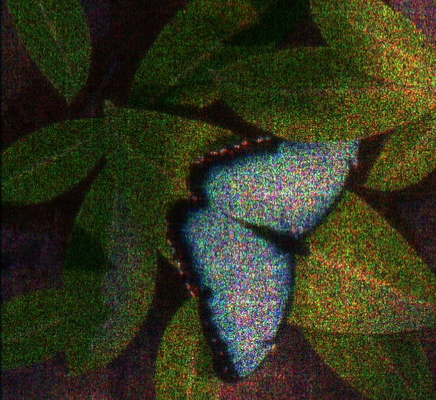
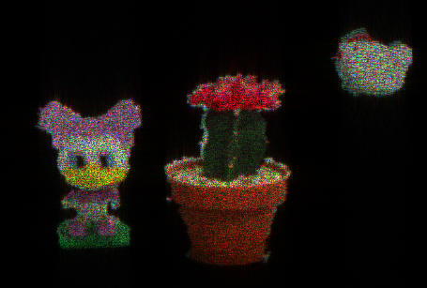
Result
Scene 1
Scene 2
Scene 3
Original Image
Original Image
Original depth & color image
Reference Image
(Original + Random phase)
Reference Image
(Original + Random phase)
Reference Image
(Original + Random phase)
Notes:
1. Tomoyoshi Shimobaba, Nobuyuki Masuda, and Tomoyoshi Ito, "Simple and fast calculation algorithm for computer-generated hologram with wavefront recording plane," Opt. Lett. 34, 3133-3135 (2009)

Slide 13
Results
Object (object point count) | Resolution | No. of depth layer | Conventional M-WRP |  |  | Proposed DM-WRP |  |  | % improved(time)
 |  |  | No. of WRP | Time (sec.) | Correlation | No. of WRP | Time (sec.) | Correlation
Scene1 (35,263) | 1980X1024 | 128 | 24 | 130.48 | 0.75 | 9 | 93.44 | 0.80 | 28.39%
Scene 2 (96,903) | 720X720 | 112 | 12 | 248.08 | 0.72 | 9 | 213.11 | 0.79 | 24.98%
Papilion (262,098) | 1280X720 | 255 | 96 | 258.76 | 0.74 | 30 | 220.49 | 0.76 | 14.79%
Table 1 : Calculation time and PSNR comparison between M-WRP and MLDR method

Slide 14
Summary and conclusion
Compared with conventional M-WRP method, proposed MLDR method is capable of faster hologram generation by at most 28%.
No. of WRP is optimized by restricting the distance between the farthest depth layers within depth ranges.
Faster full colour hologram is proven by numerical simulation of real objects and digitally synthesized object.
Future research focuses on few more real scenes and digitally synthesized scenes to evaluate our proposed method further.
Notes:
1. Tomoyoshi Shimobaba, Nobuyuki Masuda, and Tomoyoshi Ito, "Simple and fast calculation algorithm for computer-generated hologram with wavefront recording plane," Opt. Lett. 34, 3133-3135 (2009)

Slide 15
Thank you !!

Slide 16
Results
Object (object point count) | Resolution | No. of depth layer | Conventional M-WRP |  |  | Proposed DM-WRP |  |  | % improved(time)
 |  |  | No. of WRP | Time (sec.) | Correlation | No. of WRP | Time (sec.) | Correlation
Scene1 (35,263) | 1980X1024 | 128 | 24 | 130.48 | 0.75 | 9 | 93.44 | 0.80 | 28.39%
Scene 2 (84,549) | 1280X720 | 96 | 12 | 176.53 | 0.72 | 14 | 156.91 | 0.79 | 11.12%
Papilion (262,098) | 1280X720 | 255 | 96 | 258.76 | 0.74 | 30 | 220.49 | 0.76 | 14.79%
Table 1 : Calculation time and PSNR comparison between M-WRP and MLDR method

Slide 17
Results
Object (object point count) | Resolution | No. of depth layer | Conventional M-WRP |  |  | Proposed DM-WRP |  |  | % improved(time)
 |  |  | No. of WRP | Time (sec.) | Correlation | No. of WRP | Time (sec.) | Correlation
Scene1 (35,263) | 1980X1024 | 128 | 24 | 130.48 | 0.75 | 9 | 93.44 | 0.80 | 28.39%
Scene 2 (96,903) | 720X720 | 112 | 12 | 248.08 |  | 9 | 213.11 |  | 24.98%
Scene 3 (84,549) | 1280X720 | 96 | 12 | 176.53 |  | 14 | 156.91 |  | 11.12%
Papilion (262,098) | 1280X720 | 255 | 96 | 258.76 | 0.74 | 30 | 220.49 | 0.76 | 14.79%
Table 1 : Calculation time and PSNR comparison between M-WRP and MLDR method

Slide 18
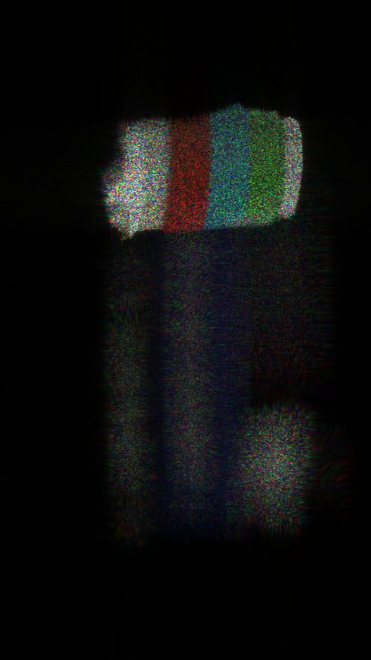
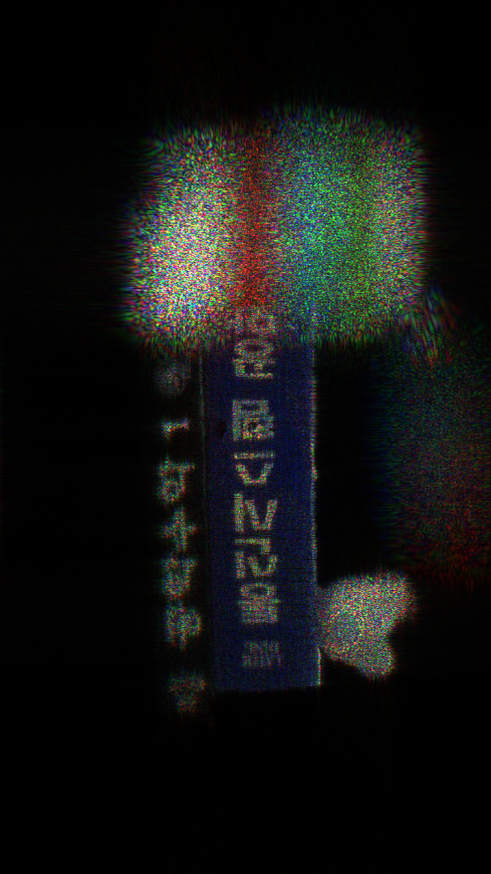
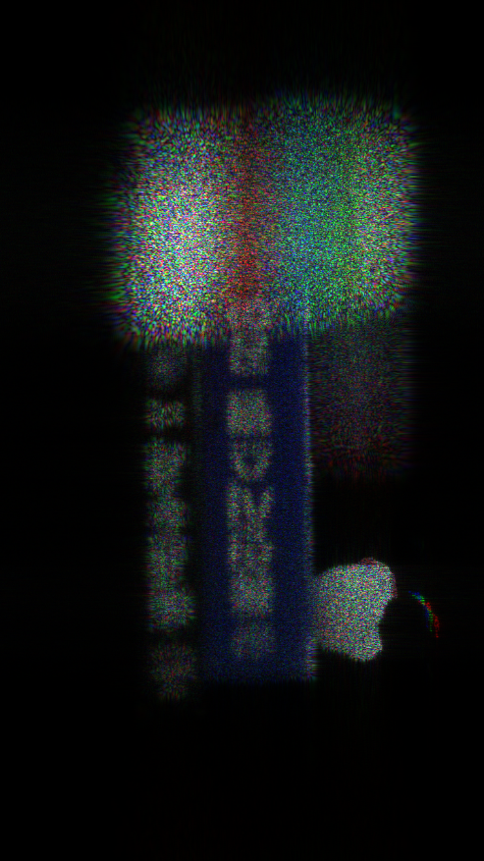
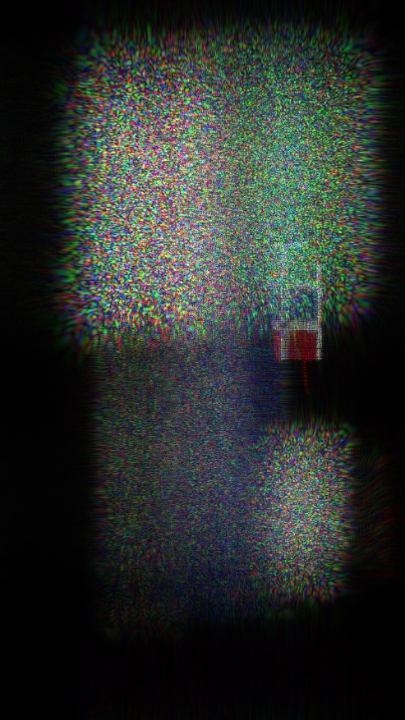


Slide 19
Wavefront recording plane (WRP) method
The WRP is a small virtual window placed between the object plane and the hologram plane. The computation time required to generate a CGH can be reduced by calculating the complex amplitude of a small region of the WRP, rather than over the entire holographic plane
displays using these methods
Putting a WRP in the middle reduces the distance for propagation and highly reduce calculation time
Eq. 1
R_{j}
Eq. 2
WRP
Eq. 3
CGH
Fig 1. Schematic diagram of hologram generation
Notes:
1. Tomoyoshi Shimobaba, Nobuyuki Masuda, and Tomoyoshi Ito, "Simple and fast calculation algorithm for computer-generated hologram with wavefront recording plane," Opt. Lett. 34, 3133-3135 (2009)

Slide 20
d
Depth
range 1
d
d
Depth
range 2
d
d
Depth
range 3
d
d
Depth
range 4
d
N(z₁) = 2
d
Depth
range 5
d
N(z₂) = 1
d
Depth
range 6
d
WRP 1
N(z₃) = 3
Depth
Range 1
d
Depth
range 7
d
Depth
range n
N(z₄) = 3
CGH
CGH
N(z₆) = 1
a)
b)
WRP 2
N(z₇) = 1
Depth
Range 2
N(z₆) = 1
N(z₇) = 2
WRP 1

Slide 21
Notes:
1. Tomoyoshi Shimobaba, Nobuyuki Masuda, and Tomoyoshi Ito, "Simple and fast calculation algorithm for computer-generated hologram with wavefront recording plane," Opt. Lett. 34, 3133-3135 (2009)

Slide 22
Point cloud
Make depth grid based on color
Calculate L
Place WRP in the center of depth ranges (created based on L) and record all object points information on respective WRP. Then, CGH is created based on Fresnel diffraction.
Color < 3
Repeat for different active area dimension
Acquisition of real objects using depth camera
Find L (L_{R}, L_{G},L_{B}) that created CGH in minimum time
Repeat for all colors (R,G, B)
Active
area < k
Generate full color CGH based on L_{R}, L_{G},L_{B}

Slide 23
Point cloud
Make depth grid based on color
Point cloud
Make depth grid based on color
Calculate L
Calculate L
Place WRP in the center of depth ranges (created based on L) and record all object points information on respective WRP. Then, CGH is created based on Fresnel diffraction.
Place WRP in the center of depth ranges (created based on L) and record all object points information on respective WRP. Then, CGH is created based on Fresnel diffraction.
Repeat for different active area dimension
Repeat for different active area dimension
Find L_{R}, L_{G}, L_{B}
No
Repeat for all colors (R,G, B)
Find L that created CGH in minimum time (L_{R}, L_{G},L_{B})
Yes
Repeat for all colors (R,G, B)
Generate full color CGH based on L_{R}, L_{G},L_{B}
Generate full color CGH based on L_{R}, L_{G},L_{B}

Slide 24
Point cloud
Make depth grid based on color
Point cloud
Make depth grid based on color
Calculate L
Calculate L
Place WRP in the center of depth ranges (created based on L) and record all object points information on respective WRP. Then, CGH is created based on Fresnel diffraction.
Place WRP in the center of depth ranges (created based on L) and record all object points information on respective WRP. Then, CGH is created based on Fresnel diffraction.
Repeat for different active area dimension
Repeat for different active area dimension
Find L_{R}, L_{G}, L_{B}
No
Repeat for all colors (R,G, B)
Find L that created CGH in minimum time (L_{R}, L_{G},L_{B})
Yes
Repeat for all colors (R,G, B)
Generate full color CGH based on L_{R}, L_{G},L_{B}
Generate full color CGH based on L_{R}, L_{G},L_{B}

Slide 25
Point cloud
Make depth grid based on color
Calculate L
Place WRP in the center of depth ranges (created based on L) and record all object points information on respective WRP. Then, CGH is created based on Fresnel diffraction.
Repeat for different active area dimension C₁, C₂…..C_{i}
No
Find L_{R}, L_{G}, L_{B}
Repeat for all colors (R,G, B)
Yes
b)
Generate full color CGH based on L_{R}, L_{G},L_{B}
a)

Slide 26
Point cloud
Make depth grid based on color
Calculate L
Place WRP in the center of depth ranges (created based on L) and record all object points information on respective WRP. Then, CGH is created based on Fresnel diffraction.
Repeat for different active area dimension C₁, C₂…..C_{i}
Find L_{R}, L_{G}, L_{B}
No
Repeat for all colors (R,G, B)
Yes
Generate full color CGH based on L_{R}, L_{G},L_{B}

Slide 27
Point cloud
Make depth grid based on color
Calculate L
Place WRP in the center of depth ranges (created based on L) and record all object points information on respective WRP. Then, CGH is created based on Fresnel diffraction.
Repeat for different active area dimension C₁, C₂…..C_{i}
Find L_{R}, L_{G}, L_{B}
No
Repeat for all colors (R,G, B)
Yes
Generate full color CGH based on L_{R}, L_{G},L_{B}
a)
b)

Slide 28
a)
b)

